Slide 1

Institute of Technology
School of Computing
Department of Software Engineering
Fundamentals of Cloud computing
“Evolution of Cloud Computing”
By Abebaw S.

Slide 2
Outline
Introduction
System Models for
Distributed Computing
Cloud Computing
NIST Cloud Computing Reference Architecture -IaaS
On-demand provisioning
Elasticity in cloud
Public, Private and Hybrid clouds

Slide 3
Introduction
What is Cloud?
The term Cloud refers to a Network or Internet.
In other words, Cloud is something, which is present at remote location.
Cloud can provide services over public and private networks, i.e., WAN, LAN or VPN.

Slide 4
Cont’d . . .
What is Cloud Computing?
It refers to manipulating, configuring, and accessing the hardware and software resources remotely
It offers online data storage, infrastructure, and application
It offers platform independency, as the software is not required to be installed locally on the PC
It making our business applications mobile and collaborative

Slide 5
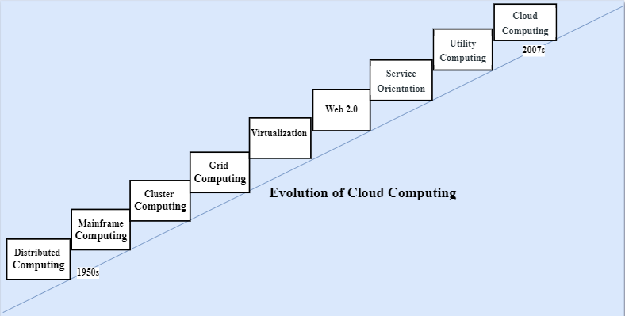
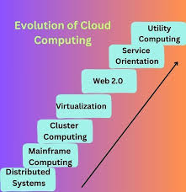
Cont’d . . .

Slide 6
Distributed System
It consists of several separate systems that are all presented to users as a single entity.
Purpose
Share resources and use them effectively and efficiently
Characteristics
Scalability, concurrency, continuous availability, heterogeneity, independence in failures.
Problem
All the systems required to be present at the same geographical location.

Slide 7
Mainframe Computing
Originally introduced in 1951.
Are highly reliable and powerful computing devices
These systems have almost no downtime with high fault tolerance.
After distributed computing, these increased the processing capabilities of the system.
Problem: Very expensive.

Slide 8
Cluster Computing
An alternative to mainframe technology to reduce the cost.
Each machine in the cluster was connected to each other by a network with high bandwidth.
These were equally capable of high computations
New nodes could easily be added to the cluster if it was required.
Geographical restrictions remained a challenge, even if the cost issue was somewhat resolved.

Slide 9
Grid Computing
To solve geographical restriction, the concept of grid computing was introduced.
It was first introduced in the 1990s
Systems were placed at entirely different geographical locations and these all were connected via the internet.
Problem: Limited availability of high bandwidth connectivity, along with other network-related problems.

Slide 10
Virtualization
Virtualization refers to the process of creating a virtual layer over the hardware.
It allows the user to run multiple instances simultaneously on the hardware
It is a key technology used in cloud computing
It is the base for major cloud computing services such as Amazon EC2, Vmware, vCloud etc.

Slide 11
Web 2.0
Web 2.0 refers to the second generation of the World Wide Web
It is the interface through which the cloud computing services interact with the clients.
It characterized by a shift from static web pages to more dynamic and interactive experiences.
It increases flexibility among web pages.
Popular examples of web 2.0 include Google Maps, Facebook, Twitter, etc.

Slide 12
Service orientation
It acts as a reference model for cloud computing
It supports low-cost, flexible, and evolvable applications.
Two important concepts were introduced in this computing model.
QoS: include Service Level Agreement (SLA)
Software as a Service (SaaS)

Slide 13
Utility Computing
Utility computing is a service model that delivers computing resources over the internet.
The resources include processing power, storage, and applications as a metered service.
Resources are provisioned on a pay-per-use basis
It allows users to access and pay for only the resources they consume.

Slide 14
Cloud Computing
Cloud Computing means storing and accessing the data and programs on remote servers that are hosted on the internet instead of the computer’s hard drive or local server.
It also referred to as Internet-based computing
It is a technology where the resource is provided as a service through the Internet to the user
The data that is stored can be files, images, documents, or any other storable document

Slide 15
Cont’d …
Disadvantages
Cost Saving
Data Redundancy and Replication
Flexibility
Reliability
High Accessibility
Scalable
Disadvantages
Internet Dependency
Issues in Security and Privacy
Data Breaches
Limitations on Control

Slide 16
System Models for Distributed Computing
Distributed computing is a system in which processing and data storage are spread across multiple devices or systems, rather than being managed by a single central device.
Distributed computing systems can be classified into various models based on their architecture, communication methods, and the way they manage resources.
Physical Model
Architectural Model
Fundamental Model

Slide 17
Cont’d …
1. Physical Model
It represents the HW elements of a distributed system.
It includes physical configuration, including the computers, other devices, and connections between them.
Mainly consists of the following components:
Nodes
Links
Middleware
Network Topology
Communication Protocols

Slide 18
Cont’d …
Nodes
Nodes are the end devices that can process data, execute tasks, and communicate with the other nodes.
These end devices are generally the computers at the user end or can be servers, workstations, etc.
Each node has an OS, execution environment, and different middleware requirements

Slide 19
Cont’d …
Links
The communication channels between different nodes and intermediate devices.
These may be wired or wireless.
The following connection types can be implemented:
Point-to-point: Set up a connection to facilitate data transfer between only two nodes.
Broadcast links: It allows one node to send data to several nodes at the same time.
Multi-Access links: Multiple nodes utilize the same communication channel for data transfer, which requires protocols to prevent interference during transmission.

Slide 20
Cont’d …
Middleware
This is a software installed and executed on the nodes.
Running middleware on each node enables decentralized control and decision-making in the distributed computing system.
It manages tasks such as communication between nodes, resource management, fault tolerance, node synchronization, and security to block unauthorized access.
Examples: RPC, JDBC, ODBC etc.

Slide 21
Cont’d …
Network Topology
It defines the arrangement of nodes and links in the distributed computing system.
The most common network topologies used are bus, star, mesh, ring, and hybrid.
Communication Protocols
Are the set rules and procedures for transmitting data from one node to others.
Examples of these protocols include TCP, UDP, HTTPS, MQTT etc.

Slide 22
Cont’d …
2. Architectural Model
It defines the overall design and organization of components, detailing how they interact to deliver the desired functions.
It provides an overview of how development, deployment, and operations will occur.
A well-designed architectural model is necessary for cost efficiency and better scalability of applications.
The main elements of the architectural model are:
Client-Server model
Peer-to-peer model
Layered model
Micro-services model

Slide 23
Cont’d …
Client-Server
It’s a centralized approach where clients request services, and servers responds to them.
Peer-to-peer
It’s a decentralized approach where all nodes, have equal computing capabilities and can both request and provide services to one another.
It’s a highly scalable model because peers can join and leave the system easily.
The best example of this type of computing is BitTorrent.

Slide 24
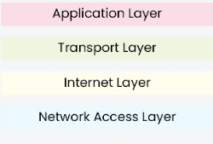
Cont’d …
Layered model
It organizes the system into multiple layers, with each layer providing a specific service.
Each layer interacts with adjacent layers through defined protocols.

Slide 25
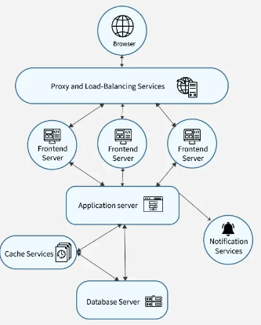
Cont’d …
Micro-services model
A complex application is divided into independent tasks that run on different servers.
Each service performs one function and focuses on a specific business capability.
This makes the system easier to maintain, scale, and understand.

Slide 26
Cont’d …
3. Fundamental Model
It refers to the core principles and components that define how these systems operate.
It represents the essential components that are required to understand a distributed system’s behavior.
There are three types of fundamental models
Interaction
Fault
Security

Slide 27
Cont’d …
Interaction Model
It handles time (i.e. for process execution, message delivery, clock drifts, etc.)
They are of two types:
Synchronous distributed system
Asynchronous distributed system

Slide 28
Cont’d …
Synchronous distributed system
Lower and upper bounds of execution time can be set.
Transmitted messages are received within a known bounded time.
It have predictable behavior in terms of timing.
Used for hard real-time applications.
Use timeouts in order to detect failures of a process or communication link.
It is difficult and costly to implement

Slide 29
Cont’d …
Asynchronous distributed system
Many distributed systems (including those on the Internet) are asynchronous.
No bound on process execution time
No bound on message transmission delays
No bounds on drift rates between local clocks.
There is no global physical time.
Reasoning can be only in terms of logical time
Are unpredictable in terms of timing.
No timeouts can be used.
Q. What is drift rates?

Slide 30
Cont’d . . .
Fault Model:
This model addresses the faults and failures that occur in the system.
Failures can occur both in processes and communication channels.
The reason can be both software and hardware faults.
Fault tolerance mechanisms are implemented by:
Replication
Error detection
Recovery methods.

Slide 31
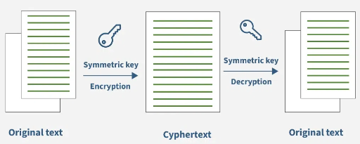
Cont’d . . .
Security Model
It helps to define the security needs, threats, vulnerabilities, and methods to protect the system and its resources.

Slide 32
Cont’d . . .
Essential components of the security model are:
Authentication: It confirms user identities to ensure that only authorized and trusted individuals can access the system.
Encryption: It is the process of changing data into a format that cannot be read without a decryption key.
Data Integrity: This mechanisms protect against unauthorized modification of data.

Slide 33
NIST Cloud Computing Reference Architecture
NIST stands for National Institute of Standards and Technology
It provides a structured framework that defines the basic building blocks of cloud computing
It offering clarity and consistency in understanding and implementing cloud solutions
It serves as a reference point for designing, deploying, and managing cloud-based systems.

Slide 34
Cont’d…
NIST cloud computing reference architecture defines five major actors:
Cloud consumer
Cloud provider
Cloud carrier
Cloud auditor and
Cloud broker.

Slide 35
Cloud Consumer
A cloud consumer is an individual or organization that uses services provided by cloud providers.
It browses the service catalog from a cloud provider, requests the appropriate service, sets up service contracts with the cloud provider, and uses the service.
The cloud consumer may be billed for the service provisioned, and needs to arrange payments accordingly.

Slide 36
Cont’d…
Cloud consumers need SLAs to specify the technical performance requirements fulfilled by a cloud provider.
SLAs can cover terms regarding the quality of service, security, remedies for performance failures.
Example: A company using cloud-based storage for its data.

Slide 37
Cloud Provider
A cloud provider is an entity responsible for offering cloud services to users
It manages the infrastructure, platforms, or software that consumers use.
Example: Amazon Web Services (AWS), Microsoft Azure, or Google Cloud Platform (GCP)

Slide 38
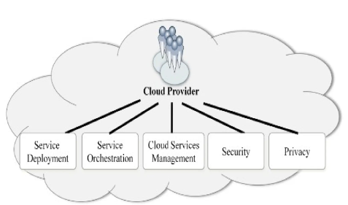
Major activities of cloud provider

Slide 39
Service deployment
Service deployment refers to the process of making an application or service available for use in a cloud environment.
There are various ways cloud services can be deployed based on organizational needs, security, and operational requirements.
Private Cloud
Public Cloud
Hybrid Cloud
Community Cloud

Slide 40
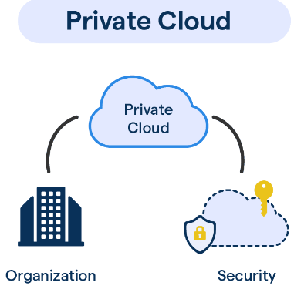
Cont’d…
Private cloud
Allows systems and services to be accessible within an organization
It operated only within a single organization.
It may be managed internally by the organization itself or by third-party.
Benefits
Higher security and privacy
Cost and Energy Efficiency
Improve reliability
More control on its resources

Slide 41
Cont’d …
Higher security and privacy
Operations are not available to general public and resources are shared from distinct pool of resources.
Cost and Energy Efficiency
Private clouds are not as cost effective as resources in public clouds but they offer more efficiency than public cloud resources.
More control on its resources
The private cloud has more control on its resources and hardware than public cloud because it is accessed only within an organization.

Slide 42
Cont’d …
Disadvantages of private cloud
Restricted area of operation: the private cloud is only accessible locally and is very difficult to deploy globally.
High priced: To meet the demand, new hardware must be bought, which is expensive.
Limited Scalability: Scalability of the private cloud is restricted to the capacity of its internally hosted resources.
Additional Skills: to manage cloud deployment effectively, an organization needs skilled professionals.

Slide 43
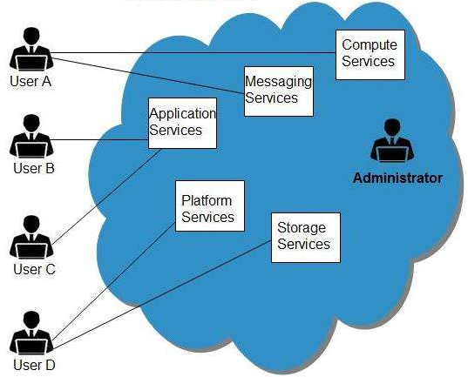
Cont’d…
Public cloud
It allows systems and services to be easily accessible to general public.
Benefits
High Scalability
Utility Style Costing
Cost Effective
Reliability
Flexibility
Location Independent

Slide 44
Cont’d…
High Scalability
Cloud resources can be accessed on demand from a shared pool, allowing for scaling up or down based on needs.
Cost effective
Since public cloud shares same resources with large number of customers it turns out inexpensive.
Utility Style Costing
Public cloud is also based on pay-per-use model and resources are accessible whenever customer needs them.

Slide 45
Cont’d …
Reliability
The public cloud utilizes a wide range of resources obtained from various locations.
If any resource fails, the public cloud can utilize an alternative.
Flexibility
The public cloud can easily integrate with the private cloud.
Location Independent:
Public cloud services are provided over the Internet.

Slide 46
Cont’d …
Disadvantages of Public Cloud
Low Security : the public cloud model does not guarantee a higher level of security because resources are shared publicly and data is hosted off-site.
Less Customizable : It is comparatively less customizable than private cloud.

Slide 47
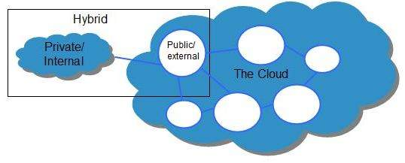
Hybrid Cloud
It is a mixture of public and private cloud.
Non-critical activities are performed using public cloud
Critical activities are performed using private cloud.
Benefits
Scalability
Security
Flexibility
Cost Efficiency

Slide 48
Cont’d …
Scalability
It offers features of both public and the private cloud scalability.
Security
The private cloud in hybrid cloud ensures higher degree of security.
Flexibility:
It offers secure resources and scalable public resources.
Cost Efficiency
Public clouds are more cost effective than private ones. Therefore, hybrid clouds can be cost saving.

Slide 49
Cont’d …
Disadvantages of Hybrid Cloud
Networking Issues: networking becomes complex due to presence of private and public cloud.
Security Compliance: It is necessary to ensure that cloud services are compliant with security policies of the organization.
Infrastructure Dependency: the hybrid cloud model is dependent on internal IT infrastructure, therefore it is necessary to ensure redundancy across data centers.

Slide 50
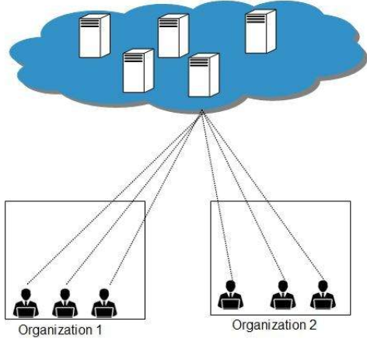
Community Cloud
It allows system and services to be accessible by group of organizations
It shares the infrastructure between several organizations from a specific community
It may be managed internally by organizations or by the third-party.
Benefits
Cost Effective
Sharing
Among Organizations
Security

Slide 51

Cont’d …
Cost Effective: community cloud gives the same benefits as a private cloud but is cheaper.
Sharing Among Organizations: community cloud allows different organizations to share cloud resources and services.
Security: The community cloud is more secure than the public cloud but not as secure as the private cloud.

Slide 52
Cont’d …
Disadvantages of Community Cloud
Relatively high cost: have higher startup costs and can be more expensive to maintain than public clouds
Rarity: It is less common than other models because it requires finding organizations with similar needs.
Limited bandwidth and storage: Sharing resources among multiple organizations can lead to concerns about bandwidth and storage capacity.

Slide 53
Service Orchestration
It refers to activities in arrangement, coordination and management of computing resources in order to provide cloud services to Cloud Consumers
Three Layer
Service Layer
Resource Abstraction and Control Layer
Physical Resource Layer

Slide 54
Cont’d…
Service Layer : This is where individual services reside ( i.e. SaaS, PaaS, IaaS )
Resource abstraction and Control
It involves creating virtual representations of physical computing resources.
This enables cloud consumers to manage the recourses and interact with virtualized resources rather than directly managing physical hardware.
Physical Resource Layer
It involves the management and coordination of physical resources in a computing environment.

Slide 55
Cloud Service Management
It refers to the processes and tools used to manage and optimize cloud services throughout their lifecycle.
Assigning and configuring physical or virtual resources needed to deliver the service.
Example: Configuring and deploying cloud services according to the requirements of the cloud consumers.

Slide 56
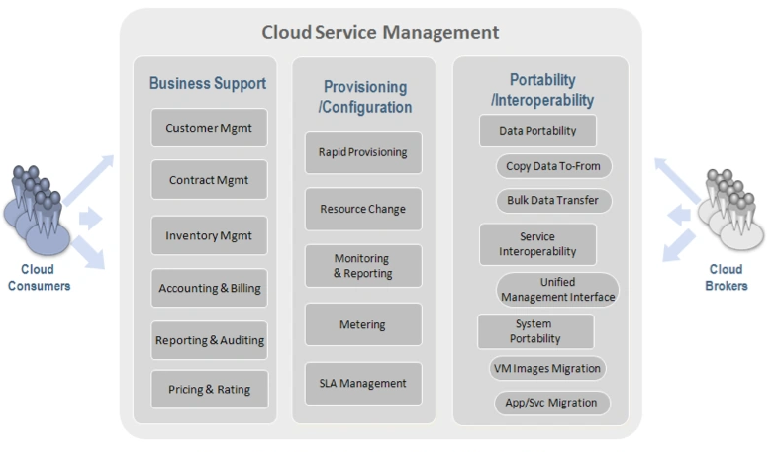
Cont’d …
Fig: Cloud provider – Cloud service management

Slide 57
Cloud Service Management
Security- To protect data and systems from unauthorized access, attacks, and other threats.
Privacy- To ensure that individuals' personal information is handled according to their preferences and legal requirements, safeguarding against misuse or unauthorized access.

Slide 58
Cloud Auditor
Security audit : Assessing whether security controls are properly implemented according to the defined policies and standards.
Privacy impact audit: To ensure that personal information is protected according to privacy laws and regulations, and that privacy risks are managed appropriately.
Performance audit - Evaluates the efficiency, effectiveness, and overall performance of cloud services and infrastructure.

Slide 59
Cloud Broker
A cloud broker acts as an intermediary between cloud service providers and cloud consumers.
They manage and optimize the use, performance, and delivery of cloud services.
Categories of Cloud Broker Services
Service Intermediation:- Enhancing existing cloud services by adding value through various capabilities.
Service Aggregation:- Combining and integrating multiple cloud services into unified offerings.
Service Arbitrage:- Selecting and managing services from different providers to meet specific needs.

Slide 60
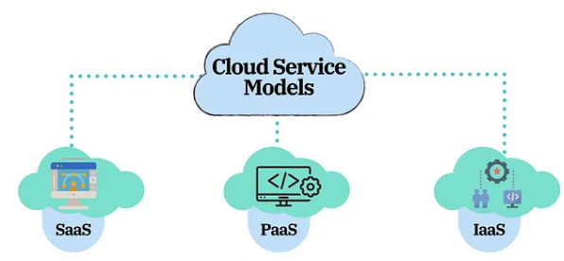
Cloud service Models
There are three types of cloud service models:
Infrastructure as a Service (IaaS)
Platform as a Service (PaaS)
Software as a Service (SaaS)

Slide 61
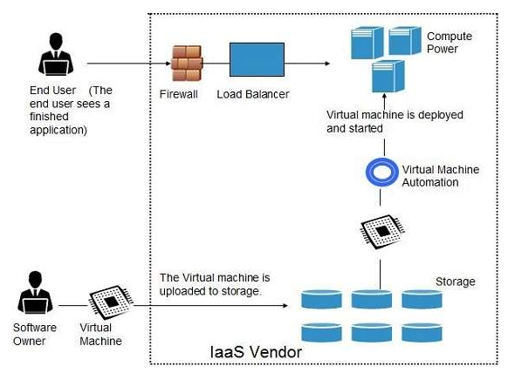
IaaS
It is a provides virtualized computing resources over the internet.
Also known as Hardware as a Service (HaaS)
It Provides access to fundamental resources such as: networking equipment, devices, database, and web servers

Slide 62
Cont’d…
Characteristics:
VMs come with software already installed.
They can have OSs like Windows, Linux, and Solaris.
Resources are available on demand, allowing data copies to be stored in various places.
You can easily scale computing resources up or down.

Slide 63
Cont’d…
Advantages:
Cost-Effective:
Eliminates capital expense and reduces ongoing cost and IaaS customers pay on a per-user basis.
Running websites using IaaS can be less expensive than traditional web hosting.
Security:
IaaS Cloud Provider may provide better security than your existing software.
Maintenance:
There is no need to manage the underlying data center or the introduction of new releases of the development or underlying software. This is all handled by the IaaS Cloud Provider.

Slide 64
Cont’d…
Disadvantages:
Limited control over infrastructure:
IaaS providers typically manage the underlying infrastructure and take care of maintenance and updates
Security concerns:
Users are responsible for securing their own data and applications, which can be a significant undertaking.
Limited access:
Cloud computing may not be accessible in certain regions and countries due to legal policies.

Slide 65
Cont’d…
Examples of IaaS Provider:
Digital Ocean
Red Hat
IBM
Microsoft
Rackspace Technology
VMware
OpenStack
LayerStack
Alibaba Cloud
Amazon Web Services etc.

Slide 66
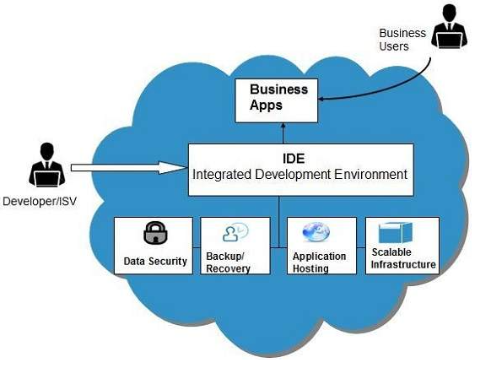
PaaS
PaaS offers the runtime environment for applications.
It also offers deployment tools required to develop applications.
PaaS has a feature of point-and-click tools that enables non-developers to create web applications.

Slide 67
Cont’d…
Characteristics
Accessible to various users via the same application.
Integrates with web services and databases.
Build virtualization technology for easy scaling.
Supports multiple languages and frameworks
Offers auto-scaling capabilities..
Advantages
Scalability: users ranges from hundreds to thousands.
Prebuilt Business Plan: vendors provide pre-defined business functionality for users to directly start the project.

Slide 68
Cont’d…
Low Cost: PaaS requires a computer & a good internet connection and less investment in hardware & software.
Instant Community: PaaS providers facilitates user providing online communities where a developer can get new ideas & share their experience & advice.
Simple & easy to use

Slide 69
Cont’d…
Disadvantages of PaaS :
Vendor Migration: Migration from one PaaS vendors' application to another PaaS vendor will create some problem.
Data-Privacy: The privacy of data can get hamper if it is not held within the company's boundary or organization.
Mix-up Complexity: Some of the applications developed may be local while others are from the cloud, which may increase the complexity.

Slide 70
Cont’d…
Examples of PaaS Providers:
Amazon Web Services
VMware Cloud Foundry
Microsoft Azure
Salesforce Lightning
Google App Engine
Red Hat OpenShift
IBM Cloud Foundry
Oracle Cloud Platform etc.

Slide 71
SaaS
SaaS model delivers software applications to end users as a service.
This software is hosted online and accessible through the Internet.
Here are some examples of SaaS applications:
Billing and invoicing system
Customer Relationship Management (CRM)
Help desk applications
Human Resource (HR) solutions

Slide 72
Cont’d…
Characteristics
Makes the software available over the Internet.
The software are maintained by the vendor.
Cost-effective since software's do not require any maintenance at end user side.
They are available on demand.
They can be scaled up or down on demand.
They are automatically upgraded and updated.
SaaS offers shared data model. Therefore, multiple users can share single instance of infrastructure. It is not required to hard code the functionality for individual users.
All users run the same version of the software.

Slide 73
Cont’d…
Characteristics
Makes the software available over the Internet.
The software are maintained by the vendor.
Cost-effective since software's do not require any maintenance at end user side.
They are available on demand.
They can be scaled up or down on demand.
They are automatically upgraded and updated.
SaaS offers shared data model. Therefore, multiple users can share single instance of infrastructure. It is not required to hard code the functionality for individual users.
All users run the same version of the software.

Slide 74
Cont’d…
SaaS providers
Google: Gmail, Calendar, Google Docs, Sheets, and other Google cloud-based productivity and collaboration tools.
Microsoft: Edge web browsers, Microsoft Office etc.
Adobe: gives users access to a collection of software developed by Adobe for graphic design, video editing, web development, photography etc.
Amazon Web Services: Amazon Chime, Amazon WorkDocs,
Salesforce: CRM, Tableau CRM

Slide 75
Thank you!

